Slide 1
PDU webinar

Slide 2
Agenda
What are PDUs
PDUs needed to maintain certification
How to obtain PDUs
Fast track to earning PDUs
Monitor your standing and register PDUs - DEMO

Slide 3
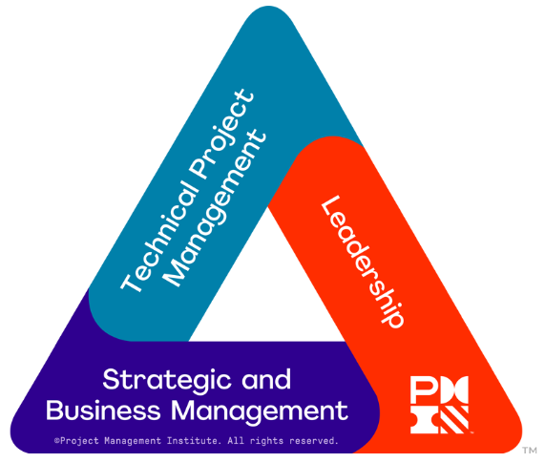
What are PDUs?
PDUs are one-hour blocks of time that you spend:
Learning
Teaching others
Volunteering
By accumulating and tracking these over your certification cycle you can maintain your certification status with PMI
PDUs are broken into two categories
Education
Giving Back (to the profession)
Education PDUs can be earned at professional seminars, webinars, classes, or even self-directed learning.
Giving Back PDUs are for time spent volunteering, mentoring, working with professional groups, and more.

Slide 4
PDU requirements - PMP
PMP®, PgMP®, PfMP®, PMI-PBA®
You need to earn 60 PDUs in a three-year cycle
Minimum 35 Education PDUs - In each of the skill areas of the PMI Talent Triangle
8 PDUs must be gained from Technical Project Management
8 must be gained from Strategic and Business Management
8 must be gained from Leadership
The remaining 11 can be gained from any area of the PMI talent triangle
Maximum 25 Giving Back PDUs
Giving Back to the Profession
Sharing knowledge and actively applying your skills is an important way to contribute to the profession, while also enriching your own professional skills. That’s why you have the option to earn up to 25 PDUs for your activities in this area.
Did you know…
There is no limit on the number of Education PDUs that you can earn — meaning that you can earn all 60 PDUs in Education if you choose

Slide 5
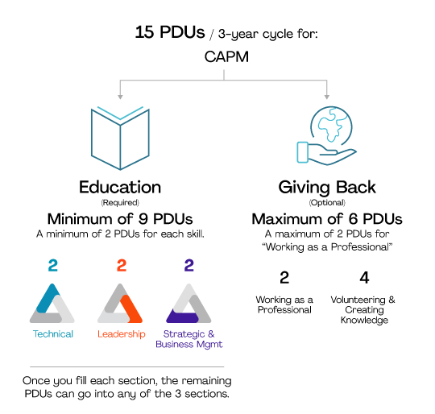
PDU requirements - CAPM
CAPM®
You need to earn 15 PDUs in a three-year cycle
Minimum of 9 Education PDUs
As it says minimum, you can earn all 15 PDUs in the talent triangle
Maximum of 6 Giving Back PDUs
You will not be accredited for more than 6 Giving Back PDUs
PMI-ACP®, PMI-RMP®, PMI-SP®
Minimum 18 Education PDUs
Maximum 12 Giving Back PDUs

Slide 6
How to earn Education PDUS
Learning activities that allow you to broaden your knowledge
Course or Training
Instructor-led formal education courses or classes held in-person or online
Virtual real-time instructor-led courses from PMI Seminars World®
Academic education through programs accredited by the PMI Global Accreditation Center (GAC)
Training courses offered by a PMI Authorized Training Partners
Disciplined Agile or PMP® certification training courses offered by a PMI Authorized Training Partner
Courses from other third-party providers
Global Events – Meetings and events that bring together the global community. Includes educational sessions, keynote, and featured speakers – (Typically, 7–50+ PDUs)
Local Meetings
Online or Digital Media
Reading
Informal Learning
For seminars, training and events exceeding two hours you will usually be given a PDU claims code. You can find claims codes for previous events by searching C226 PMI Norway Chapter.

Slide 7
How to earn Giving Back PDUs
Work as a Practitioner
By working in your certified role, you can earn PDUs by applying your knowledge and skills in a practical setting
Create Content
Webinars
Videos
Blog posts
Etc.
Give a Presentation
If you speak at your organization, at a PMI chapter event or a conference, you can claim PDUs for it…
Share Knowledge
Others can benefit from your experience and knowledge. Keep track of the time you spend mentoring and teaching and claim it towards re-certification
Volunteer
PMI Board of Directors
Board Support Committees
Chapter Volunteers
Activities that enable you to share and apply your knowledge and skills as a means to contribute to and help build the profession

Slide 8
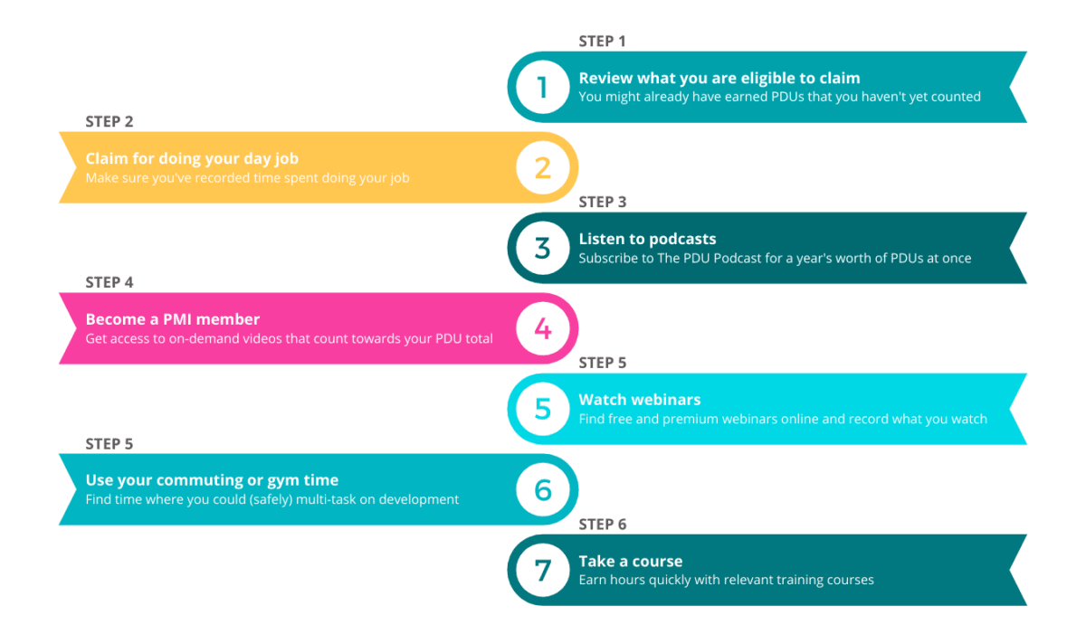
Fast track to earning PDUs

Slide 9
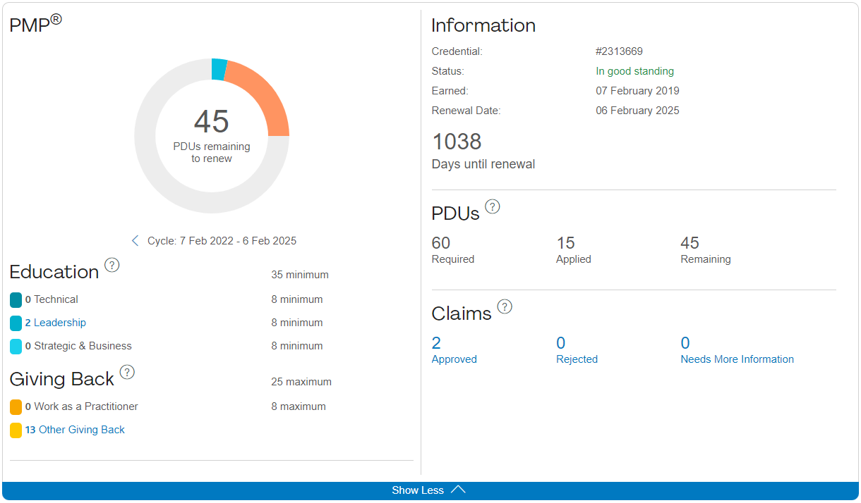
Monitoring PDU standing Your personal PDU dashboard
https://ccrs.pmi.org/

Slide 10
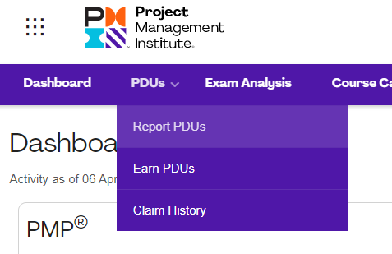
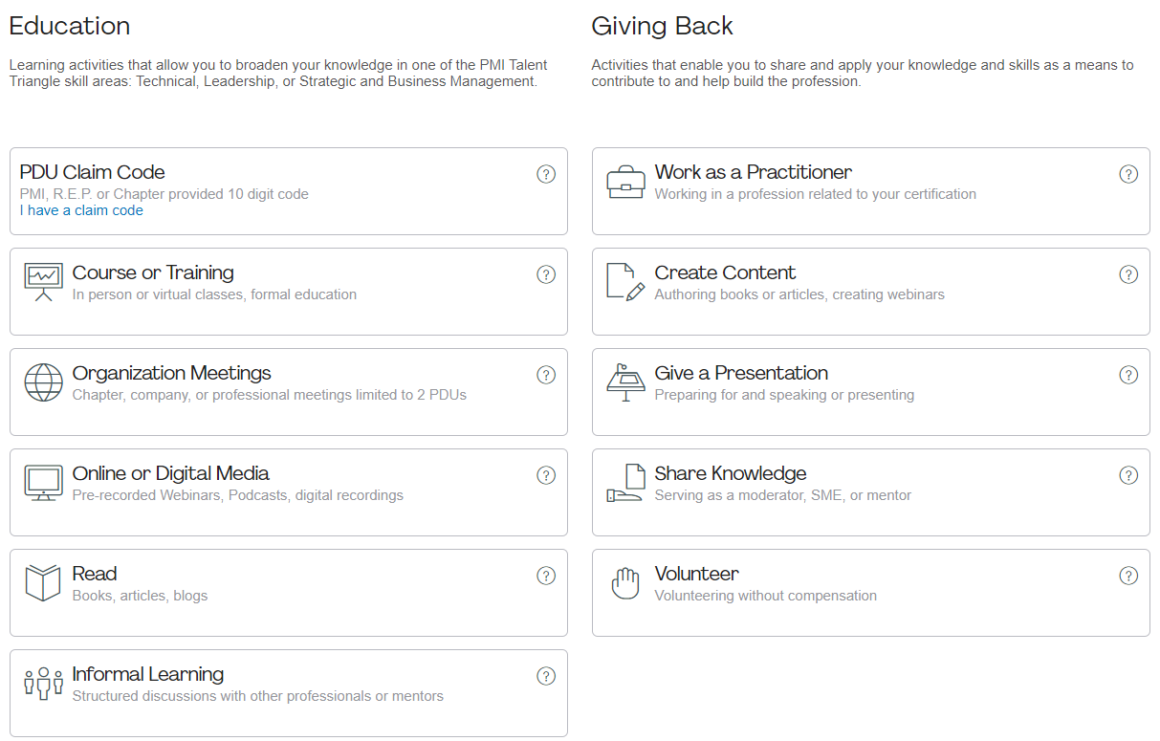
DEMO
Examples…
Go to: https://ccrs.pmi.org/
Special cases
You cannot report practitioner PDUs if your certification is suspended, as you are not “allowed” to work as a practitioner. You must report education PDUs
PDUs can be transferred to your next PDU period

Slide 11
THANK YOU ANY QUESTIONS?
28

Slide 12
Resources
Maintaining your certification: https://www.pmi.org/certifications/certification-resources/maintain
Ways to earn Education PDUs: https://www.pmi.org/certifications/certification-resources/maintain/earn-pdus/education
Ways to earn Giving Back PDUs: https://www.pmi.org/certifications/certification-resources/maintain/earn-pdus/contribute
Registering PDU claim: https://ccrs.pmi.org/claim
Creating content: https://www.projectmanagement.com/contentPages/page.cfm?ID=192846&thisPageURL=/pages/192846/Contribute-Content-to-ProjectManagement-com#_=_
Writing an article: https://www.projectmanagement.com/Knowledge-Shelf/

